Slide 1
Reversible Circuits and Universal Gates
不正经讲师：理科宅Hunt

Slide 2
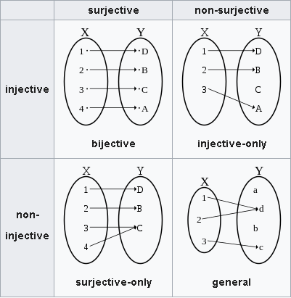
Reversible function
A function is reversible if and only if it is bijective.

Slide 3
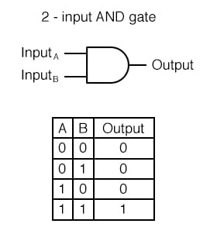
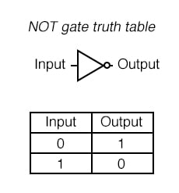
Reversible circuits in classical computing
Gates in classical computing are not always reversible.
Example: NOT gate is reversible; AND gate is not reversible.

Slide 4
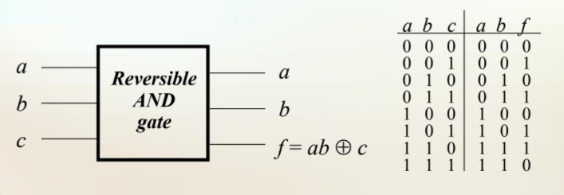
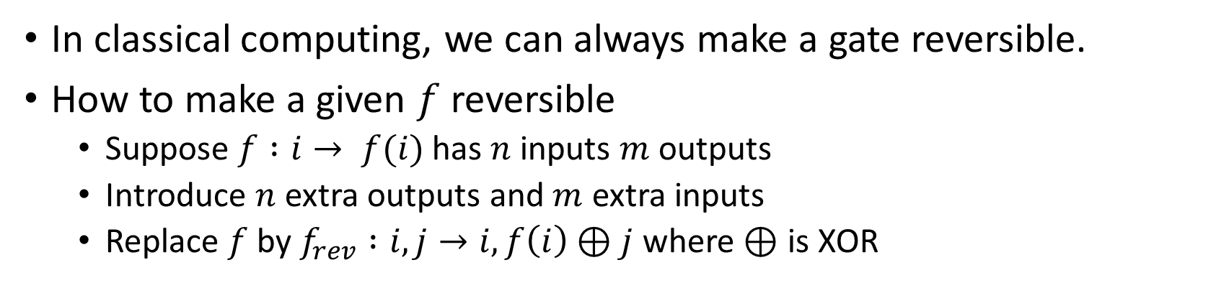
Reversibility in classical computing
In classical computing, we can always make a gate reversible.
How to make a given $f$ reversible
Suppose $f :i→ f(i)$has $n$ inputs $m$ outputs
Introduce $n$ extra outputs and $m$ extra inputs
Replace $f$ by $f_{rev} :i,j→i,f\left(i\right)⊕j$ where $⊕$ is XOR

Slide 5
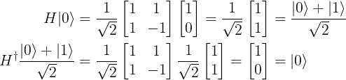
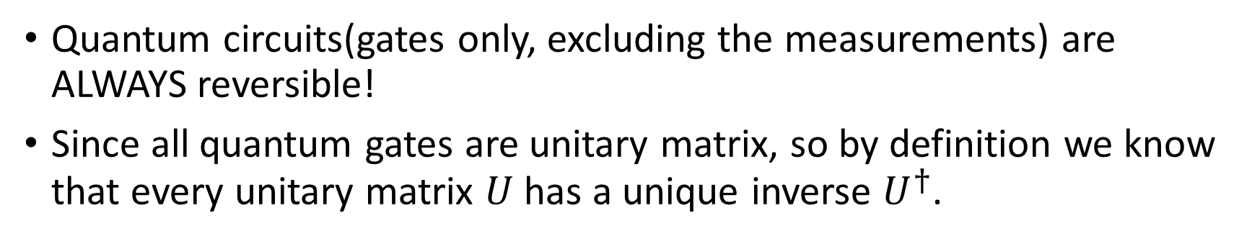
Reversibility in quantum computing
Quantum circuits(gates only, excluding the measurements) are ALWAYS reversible!
Since all quantum gates are unitary matrix, so by definition we know that every unitary matrix $U$ has a unique inverse $U^{†}$.
Reverse of Hadamard gate

Slide 6
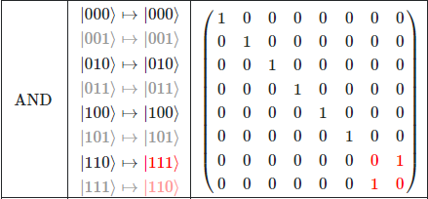


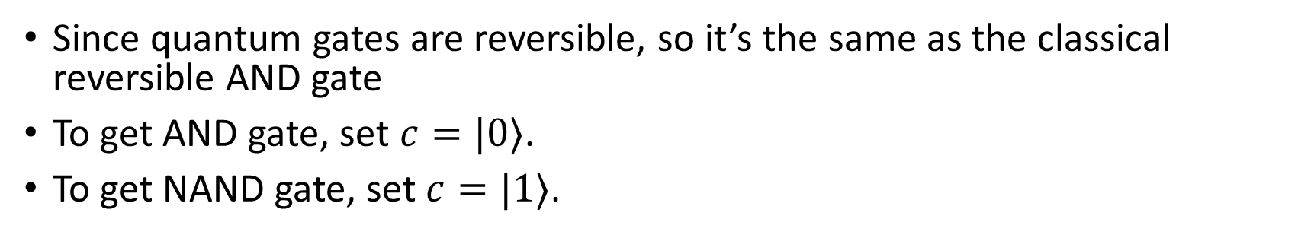




Example – Quantum AND gate
Since quantum gates are reversible, so it’s the same as the classical reversible AND gate
To get AND gate, set $c=|0⟩$.
To get NAND gate, set $c=|1⟩$.
$$a$$
This is a AND gate if c=0;
This is a NAND gate if c=1.
$$a$$
$$b$$
$$b$$
$$c$$
$$\left(ab\right)⊕c$$

Slide 7
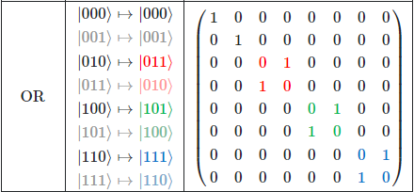






Example – Quantum OR gate
Reversible OR gate in classical computing suits our purpose
$$a$$
This is a OR gate if c=0;
This is a NOR gate if c=1.
$$a$$
$$b$$
$$b$$
$$c$$
$$\left(a∨b\right)⊕c$$

Slide 8

Universal gate sets
We can APPROXIMATE any unitary operators to any given precision by finite number of gates. (Similar to Taylor series)
The set of gates that does this job is called universal gate set.
For example:
$\{Hadamard,Phase,π/8,CNOT\}$
$\{Hadamard,Phase,Toffoli,CNOT\}$

Slide 9

Decomposition of unitary matrix
A $d$-dimensional unitary matrix $U$ can be decomposed into products of two-level unitary matrices
$$U=V_{1}V_{2}⋯V_{k}$$
Where $k≤\left(d−1\right)+\left(d−2\right)+⋯+1=d(d−1)/2$.
This means we can use two-level unitary matrices to represent any unitary matrices.

Slide 10
Summary
Quantum circuits are always reversible.
We can use 4 gates to approximate any unitary operations.

